Slide 1



Galanakis Michalis MSc Applied Statistics student at AUEB ΑΜ: P3622004
Clinical Trials Assignment 2 Presentation
11/7/2022

Slide 2
Objective and Purpose
Objective: The client wants to include a PRO label claim in their European Medicine Agency submission and asked to perform the analyses on the PRO-related endpoints.
Purpose: Our primary goal is to examine if there’s a difference between the 2 proposed treatments in each of the time points provided.
Endpoints: Primary endpoint is metastatic free survival. Among the secondary endpoints, patient reported outcomes (PRO) were included. For the current task, it will be assumed that the client is only interested in the global health status (GHS)/quality of life (QoL). The outcome variable reflecting GHS/QoL takes values from 0-100; higher score indicates better quality of life.

Slide 3
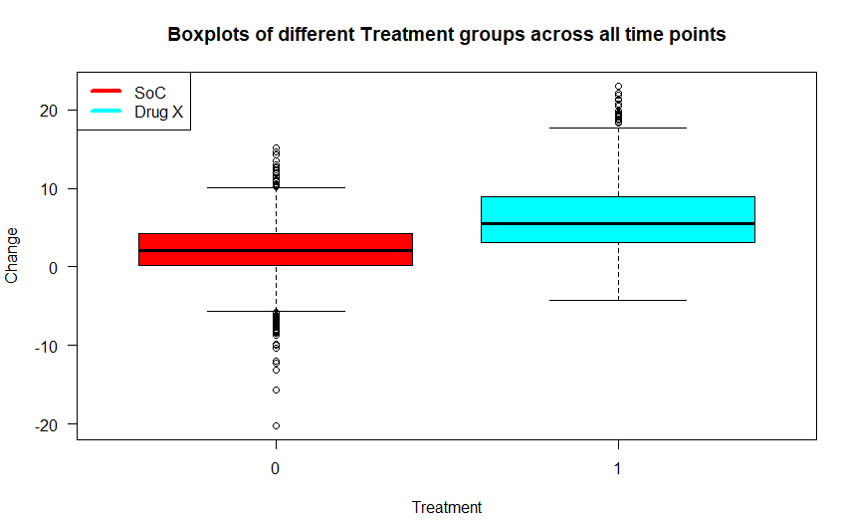
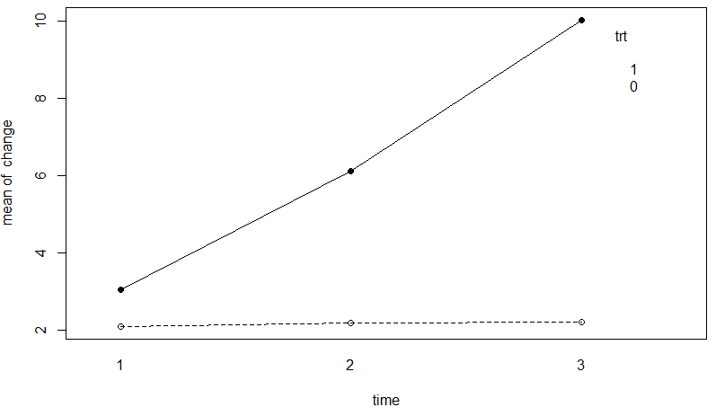
Descriptive Statistics and Graphs
Let us visualize the impact of different treatment groups on change variable across all time points:
Descriptive statistics to better understand our data:

Slide 4
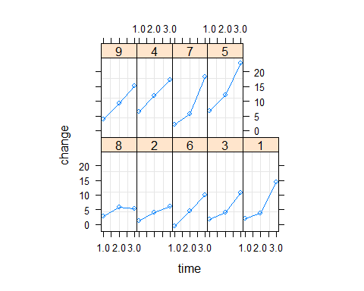
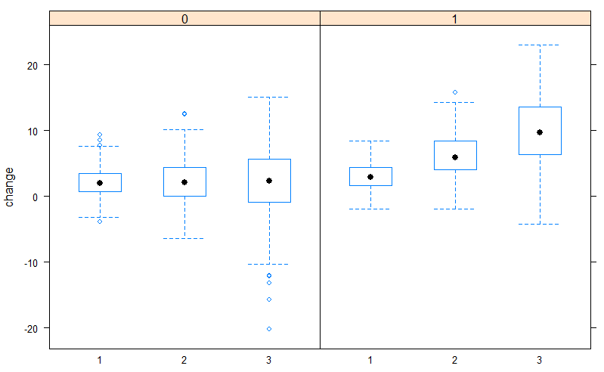
Descriptive Statistics and Graphs
Let us visualize the impact of different treatment groups on change variable across all time points:
Profile plot per subject:

Slide 5
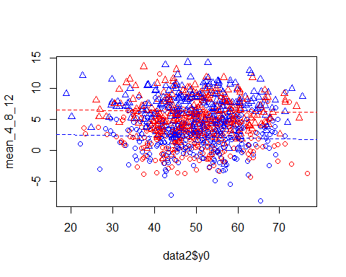
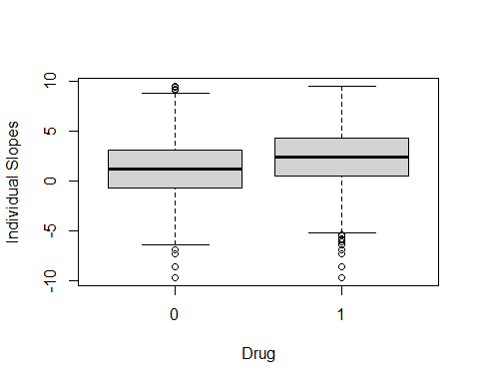
Descriptive Statistics and Graphs

Slide 6

Simple Analyses
Ancova analysis: Indicates that there’s a difference between the 2 treatments (statistically significant term the treatment!). Note it’s the same as implementing a glm gaussian model!
1
Change analysis: Once again the treatment is statistically significant.
2
Post analysis: Indicates that the effect of the factor treatment is statistically significant.
3

Slide 7
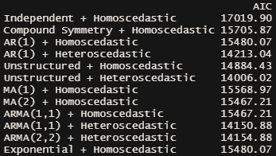
Fitting Marginal Models
As regards the marginal models fitted, based on AIC, the best one is the model with the Unstructured Covariance matrix with heteroscedastic errors.

Slide 8
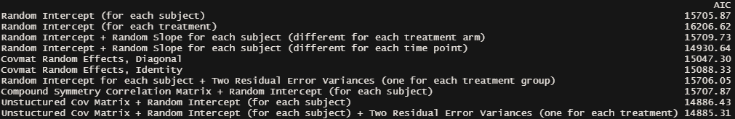
Fitting Random Effects Models
As regards the random effects models fitted, based on AIC, the best one is the model with the Unstructured Covariance matrix with a random intercept for each subject and two residual error variances (one for each treatment group).

Slide 9
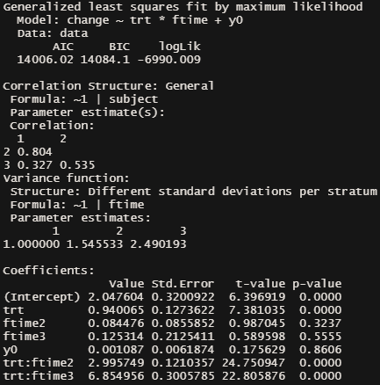
Inference on the model of our choice
trt = 0.94 : Η μέση διαφορά του change μεταξύ ασθενών που λαμβάνουν Drug X και SoC στην 1η χρονική στιγμή (και είναι στατιστικά σημαντική).
trt:ftime2 = 2.99 : Η διαφορά των ρυθμών αλλαγής των ασθενών που λαμβάνουν Drug X-SoC, δηλαδή οι ασθενείς που λαμβάνουν Drug X έχουν μεγαλύτερη διαφορά μεταξύ των χρονικών στιγμών 1 και 2 (και είναι στατιστικά σημαντικός όρος).
trt:ftime3 = 6.85 : Η διαφορά των ρυθμών αλλαγής των ασθενών που λαμβάνουν Drug X-SoC, δηλαδή οι ασθενείς που λαμβάνουν Drug X έχουν μεγαλύτερη διαφορά μεταξύ των χρονικών στιγμών 1 και 3 (και είναι στατιστικά σημαντικός όρος).

Slide 10
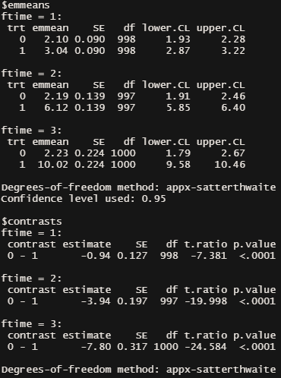
Purpose of our analysis and interpretations
Aim: Find out whether there’s a difference between the 2 proposed treatments in each of the time points provided.
Multiple comparisons at different time points for each treatment
We observe that mean change for patients receiving SoC treatment is 2.1 at the first time point (which refers to Week 4), while mean change for patients receiving Drug X is 3.04.
We observe that mean change for patients receiving SoC treatment is 2.19 at the second time point (which refers to Week 8), while mean change for patients receiving Drug X is 6.12.
We observe that mean change for patients receiving SoC treatment is 2.23 at the third time point (which refers to Week 12), while mean change for patients receiving Drug X is 10.02.
Note that we do trust the point estimates and the standard errors but not the p_values when using emmeans (p_values can get quite conservative!).

Slide 11
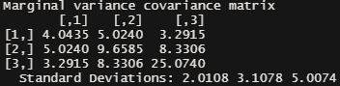
Interpretations
Για τον αδόμητο πίνακα διακύμανσης-συνδιακύμανσης του μοντέλου της επιλογής μας, έχουμε ότι:
Στην διαγώνιο του πίνακα βρίσκονται οι διακυμάνσεις των Yi για κάθε χρονική στιγμή, i=1,2,3.
Τα μη διαγώνια στοιχεία του πίνακα είναι οι συνδιακυμάνσεις, δηλαδή τα Cov(Yij,Yij’).
Note that: Var(jk)=(σ^2)*θ(jk)
Π.χ. για την ερμηνεία, έστω το: Cov(Yi1,Yi2) = 5.02 => Cor(Yi1,Yi2) = 5.02/(sqrt(4.0435)*sqrt(9.6585)) = 5.02/6.249332 = 0.8032859 > 0. Αυτό λοιπόν σημαίνει ότι εφόσον έχουμε υψηλή τιμή την 1η χρονική στιγμή θα έχουμε υψηλή τιμή και την 2η χρονική στιγμή!

Slide 12
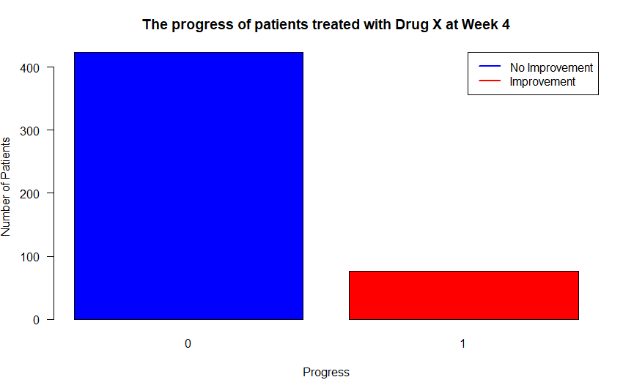
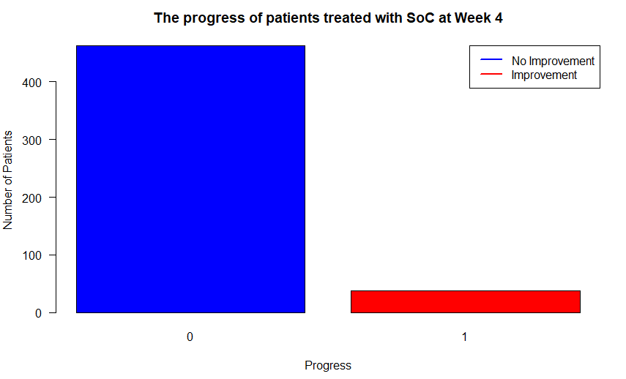
Visualizations
The improvement and non-improvement status for both treatment groups, at Week 4 can be illustrated below:

Slide 13
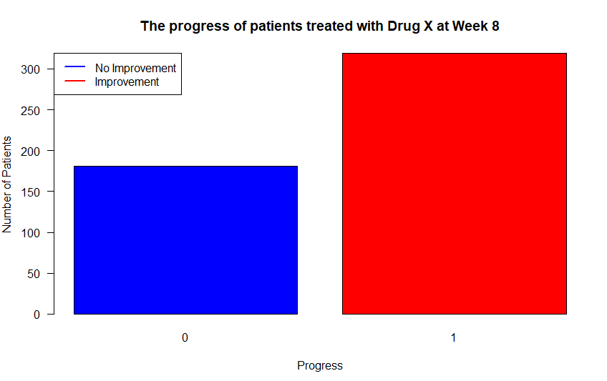
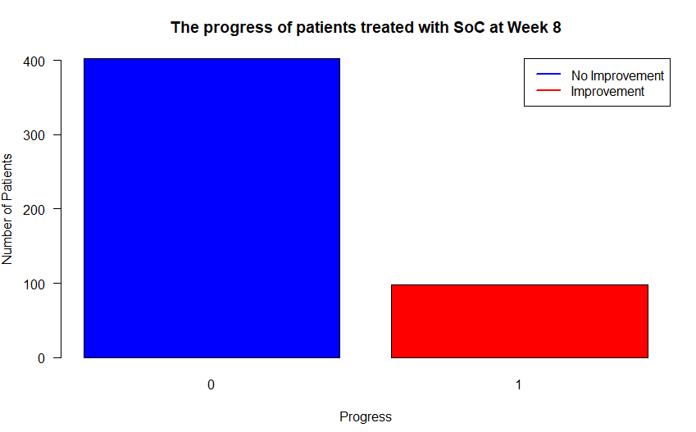
Visualizations
The improvement and non-improvement status for both treatment groups, at Week 8 can be depicted below:

Slide 14
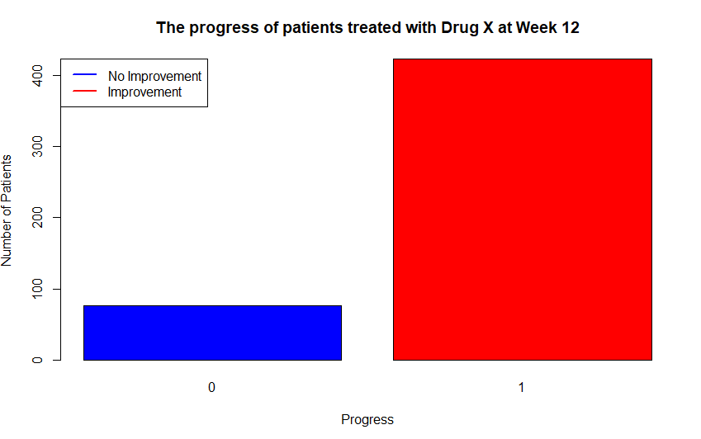
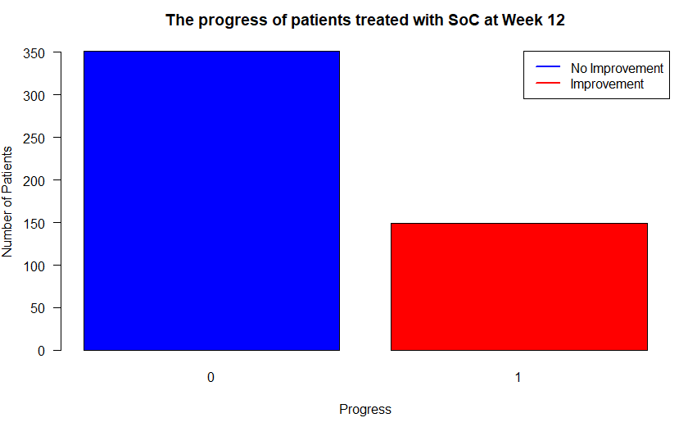
Visualizations
The improvement and non-improvement status for both treatment groups, at Week 12 can be depicted below:

Slide 15
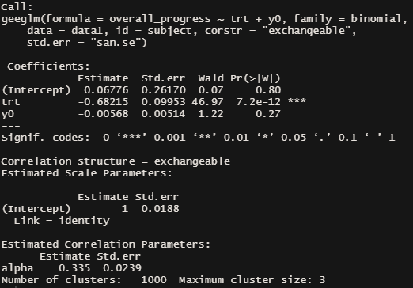
GEE Approach
Fitting a gee binomial model, choosing compound symmetry correlation structure and after modeling the mean, the output can be depicted as follows:
The interpretation of the gee binomial model (after fitting the model with the treatment only) can be done by exponentiating the model’s coefficients. The results can be illustrated as follows:

Slide 16
Conclusions
Taking into account correlations of the repeated measurements leads to fitting a better model.
Marginal models fit better our data than random effects (subject specific) models.
There’s a significant impact of different time points on change variable for patients receiving treatment Drug X, while the same does not apply for treatment SoC.
At Week 4 the progress made by both treatment groups is not great.
At Week 8 it’s obvious that patients receiving Drug X lead a better quality of life, in contrast with patients receiving Soc.
At Week 12 the results are overwhelming. The vast majority of patients receiving Drug X make progress, once again in contrast with patients receiving Soc.

Slide 17
Thank you!

